Slide 1
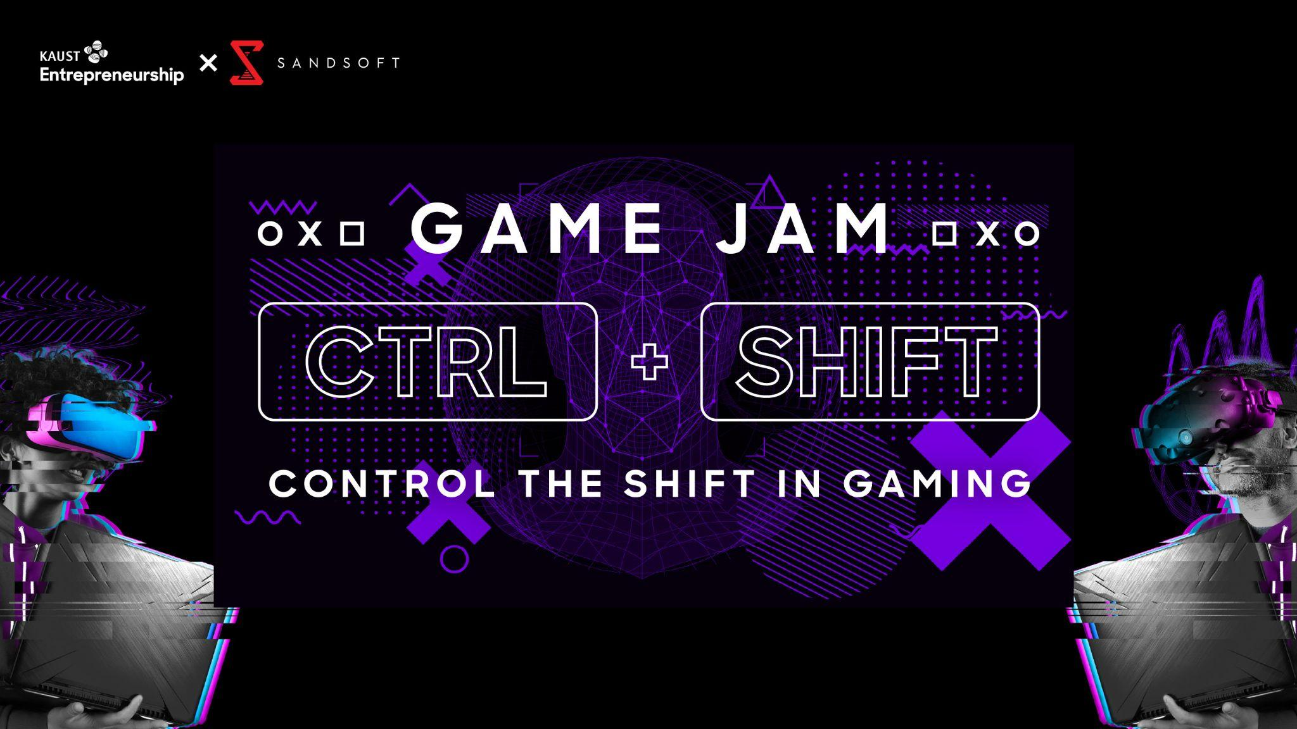
KAUSTxSandsoft Game Jam
Participant’s Brief

Slide 2
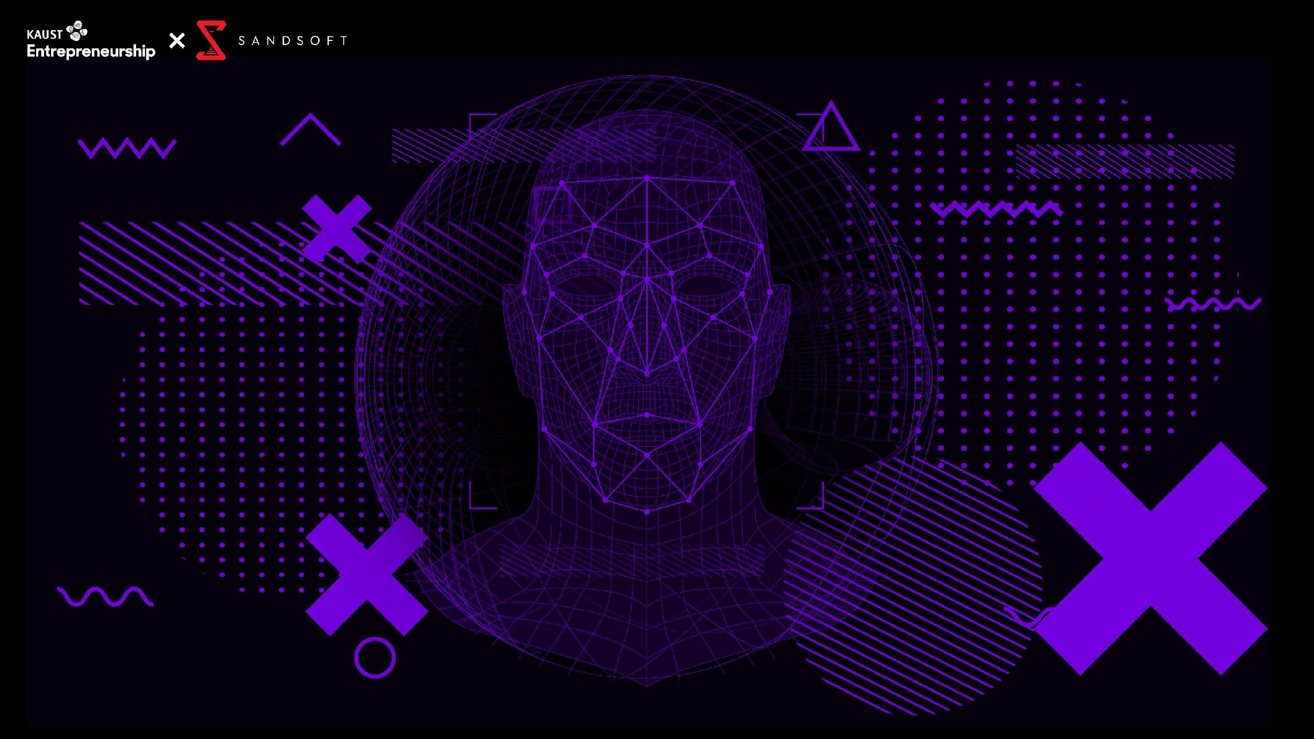
The KAUST Entrepreneurship Center joins forces with Sandsoft to call upon the best talents through the Game Jam event. Participants will spend 48 hours creating games based on a secret theme.
KAUSTxSandsoft Game Jam focuses on guiding talented participants to succeed in the games industry through innovation in science and technology relating to games. Mentors will be available throughout the event to support with guidance and solving game-related challenges.
Your challenge, should you choose to accept it, is to create a game between Thursday, the 11th of Nov and Saturday, the 13th of Nov incorporating the theme.
On Nov 13th at the end of the event on day 3, the judging panel will evaluate the games, announce winners and grant prizes.
You’re free to use any tools, game engines, libraries, and languages you like to create your game.
You’re free to start with any base-code you may have.
You’re free to use 3rd party Artwork/Music/Audio assets, or assets you previously created, as long as you have the legal right to use them (Public Domain, things you licensed/created, etc). If you don’t have the right to use something, it is your responsibility.
There’s no design experience necessary and no technical expertise either. Really, all that’s needed is a willingness to set aside some time, a desire to collaborate, and let folks know.
At the end of the Game Jam, you must submit a video of your game idea or walkthrough of your actual playable game that is not longer than 5 min (refer to the submission and judging slide for more details).
Note: This will be intense and fast-paced, so bugs and bumps in the road are expected. Focus on having fun!
About
KAUSTxSandsoft Game Jam

Slide 3
Date: November 11th – 13th , 2021
Time: Thursday 4 PM – Saturday 7 PM (GMT+3)
Zoom link: https://kaust.zoom.us/j/98961171317
Communication and Community:
Discord will be the main tool used for communication during the jam.
Join the discord server through the following link https://discord.gg/a2CarGsxkE
Game Jam Components
Workshops and Sessions: Incredible sessions by Industry leaders in game design, story creation, to sound engineering as well as discussion on the future of the industry.
Mentorship: Group mentorship and 1on1 discussion will occur on the Discord server under the “Mentorship” category.
Game Jam Highlights
Setup and Prepare
Internet: Make sure you have a strong and stable network connection. Ethernet cables are recommended over WiFi.
Software: Download latest version of Zoom & Discord. Make sure to use the phone and desktop app rather than the web version for a better experience. In addition to Zoom and Discord, also make sure to download and updated everything else you need before hand.
Environment: Find a comfortable and quiet spot, notify everyone that you will be occupied everyday at this time to help you focus.
Stationary: Pens, papers, post-it notes, and a notebook go along way when prototyping and ideating.
Food, Snacks & Water: Stock Up! Get your favorite snacks, make time to eat, and remember to stay hydrated.
Breaks: You might feel the urge to work around the clock, however for the best outcome we recommend to set timers for breaks and to sleep well.

Slide 4
Thursday, November 11th
4:00 PM | Welcome | Zoom
4:02 PM | KAUST Introduction
4:03 PM | Sandsoft Introduction
4:06 PM | Once Upon a Game Jam
4:16 PM | Structure, Rules and Awards
4:26 PM | Theme Revealed
4:30 PM | Q&A
4:40 PM | Let the games begin!
Till End of Day | Mentorship is available | Discord
Agenda Day 1
Note: time zone followed is KSA time (GMT +3)
Game Jam Roadmap Continued

Slide 5
Friday, November 12th
From the start of the day | Mentorship is available | Discord
10:00 AM | Art & Animation | Zoom
 | Mentorship is available | Discord
7:00 PM | Audio Session | Zoom
8:00 PM | Prototyping a Game for a Jam
8:30 PM | How to Make a Narrative for a Game
Till End of Day | Mentorship is available | Discord
Agenda Day 2
Note: time zone followed is KSA time (GMT +3)
Game Jam Roadmap Continued

Slide 6
Saturday, November 13th
From the start of the day | Mentorship is available | Discord
3:00 PM | Submission Deadline | Itch.io
3:01 PM | Break, stretch, do Yoga. Eat. Do NOT Oversleep! | -
4:00 PM | Sandsoft Session on Careers | Zoom
5:00 PM | Where is the Next Hollywood of Video Games?
5:40 PM | What Investors are Looking For in a Game
6:00 PM | Awards Ceremony
7:00 PM | Farewell, and see you in the next Jam!
Agenda Day 3
Note: time zone followed is KSA time (GMT +3)
Game Jam Roadmap Continued

Slide 7
There will be winners in 5 categories. In no particular order, kindly refer to the below list for the award categories with the prizes per category.
Best of Jam Logo Design
Prize: Oculus Quest 2 Advanced All-in-One VR Headset
Best use of Theme
Prize: Apple Watch Series 7
Awards
Excellence in Art
Prize: Wacom One Drawing Tablet
Game Jam Roadmap Continued
Excellence in Narrative
Prize: Nintendo Switch
Excellence in Audio
Prize: Sennheiser Momentum Over-Ear Headphones

Slide 8
Before you Submit your game, you’ll need a few things:
Link to your game that’s hosted somewhere
Some screenshots of your game.
A gameplay video recording of your game
An account on Itch.io
A name for your game
Submission
Submission Process:
Game Jam Roadmap Continued
At the end of the Game Jam, you must submit a video of your game that is a maximum of 5 min or less.
If you have a playable game, kindly submit that as well
Be sure to add the names of the team members in the submission entry
Submissions will be on Itch.io through the following link https://itch.io/jam/kaust-sandsoft-game-jame
Submission steps: Register on itch > upload your game to your profile > open the KAUSTxSandsoft Game Jam page and submit your game.
You must submit your game on Itch.io no later than 3 PM (GMT+3) on Saturday (November 13th)

Slide 9
The judging criteria includes:
Innovation – The unexpected. Things in a unique combination, or something so different it’s notable.
Fun – How much you enjoyed playing a game. Did you look up at the clock, and found it was 5 hours later?
Theme – How well an entry suits the theme. Do they perhaps do something creative or unexpected with the theme?
Graphics – How good the game looks, or how effective the visual style is. Nice artwork, excellent generated or geometric graphics, charming programmer art, etc.
Audio – How good the game sounds, or how effective the sound design is. A catchy soundtrack, suitable sound effects given the look, voice overs, etc.
Humor – How amusing a game is. Humorous dialog, funny sounds, or is it so bad it’s good? Mood – Storytelling, emotion, and the vibe you get while playing.
Overall – Your overall opinion of the game, in every aspect important to you.
Judging
Game Jam Roadmap Continued

Slide 10

Form your team
Form a team beforehand or create one from the discord “Team Formation” category
Align early on your collective goals
Align on the decision making process. Similar to defining your goal, this is a critical step as it will reduce the chance of conflict during the jam between team members
2 schools of thought with making decisions
Either the whole team forms a consensus
Assign decision making to individuals based on their area of expertise
Tips for Success
Place time limits on the different phases of your development process
Game Jam Roadmap Continued
In order to make sure you have enough time to meet your software objectives
We would highly recommend to use the MoSCoW prioritization method
Also known as the MoSCoW method or MoSCoW analysis, is a popular prioritization technique for managing requirements
https://www.productplan.com/glossary/moscow-prioritization/
As we always say, “Start small you can always add more later on.”

Slide 11
30 min in, Planning and Alignment:
Decide who plays what role in your team?
How will you make decisions?
What is the team goal?
1 Hour in, Design Lock:
Team agrees on a high-level design.
What will the final deliverables look like?
2 Hours in, Full Deliverable List:
This would detail all the specific mechanics and assets that would be needed for the final deliverable.
44 Hours in, Content Lock:
This is the point where all content is in the build and only tweaks to existing code and assets remain.
46 Hours, in Tuning Lock:
This is where all the final tuning of the exercise is complete. the game is essentially done except for any last-minute bugs.
47 Hours in, Bug Fixing and Submission:
Last hour should be for unforseen last minute items and to export and submit
48 HOUR JAM TIMELINE
PLANNING & ALIGNMENT
00:30
DESIGN LOCK
1:00
DELIVERABLE LIST
2:00
CONTENT LOCK
44:00
TUNING LOCK
46:00
BUG FIXING & SUBMISSION
47:00

Slide 12
1. Ideation: Now brainstorm and identify the right idea for your game. Come up with many ideas and choose a “doable” one — not necessarily the best one. As they come up with ideas, groups should consider the following:
Game play: What will it look like when they’re playing?
Prep: What has to happen before anyone starts playing?
Game board: Where is it played? What are the physical constraints of play?
Rules: What are the rules of play? Keep it simple!
Winning: How does one win? Or When does it end?
2. Prototyping: Paper prototyping is one of the most important techniques, even if the final design is paperless. Prototyping can include storyboards or ‘maps’ of the game, level concepts, ‘wire– frame’ drawings of screens the player would see, scripts, slide shows (with buttons!), or index cards organized to show game options. If the first prototype was really terrible, here’s your chance to take what you learned and go in a new direction with it. If the first prototype was workable, here’s your chance to supplement it with a additional factors that enhance it.
3. Build the game: Building the game requires programming skills or the use of a rapid prototyping tool (like ARIS) to build working versions of the game.
4. Playtesting I: The only way to truly understand the dynamics of your game is to playtest it. The key to playtesting is early and often. Playtesting will help your team “find the fun” in your game and prioritize design decisions so that your project stays within the scope of something you can actually make and something people actually want to play.
5. Prioritizing: Figuring out what is the most important aspect of a game and building from that, while slashing everything else, is one of the most painful endeavors even for the most experienced designers. It’s also a secret to the success of most games. This will help make it easier to get into production with a design that is actually doable!
Game Jam Roadmap

Slide 13
6. Production: This is where all of the elements come together and the true test of the technology and your skills come into play. Look for tools that multiple people can use at the same time such as Google Docs.
7. Playtesting II: Playtesting your game while in production serves several functions: it helps you see whether the technology is working before you build too much, it helps you find bugs, and it keeps you honest. The proof of a game is not in its graphics, code, or concept, but in its playtest.
8. Give each other feedback on the game: Discuss what worked, and what didn’t, and what might work better. This is where designers learn from each other and where you get to more complex points and issues that you noticed during the process. We would highly recommend to utilize the 🔍looking-for-feedback-ملاحظات channel on discord for this step.
9. Refine the game: After building and seeing other teams’ games,here is your chance to return to your own game and apply lessons, ideas, and suggestions to your own game design.
10. Finishing Touches: This is also time to add final polish. Give your game a title if you haven’t already.
Give the latest version another quick playtest. Look for dead ends or actions that break the game and figure out how to roll them into continued gameplay.
Write down the rules. As much as possible, the rules should be as intuitive or implicit as possible, with clues on how to play built into the title, theme, or gamespace — but any additional rules should be clearly written.
Game Jam Roadmap Continued
Game Jam Roadmap Continued

Slide 14
When it comes to communicating with your fellow teammates, you are not restricted to use any particular platform. This decision is totally up to you and the rest of your team.
Below are a few suggested communication and management software, in addition to a step-by-step process on how to use the Group DM feature on Discord:
Discord
For file/screen sharing and communication
For a step-by-step guide on how to set-up the Group DM/Chat and Calls, click HERE
Note that you are only able to have a maximum of 10 people in a group DM.
Slack
File sharing and communication
Trello
Task planning
Team Communication Tools
Game Jam Roadmap Continued

Slide 15
Kindly find below a brief overview of each of the channels in the server:
Discord Tutorial
Start Here
👋welcome-مرحبا-بكم : This is your first step; you'll find an introduction to the Discord channel. In addition to all resources, you need related to the jam, agenda, timeline, etc...
📢announcements-الإعلانات : This channel will contain multiple announcements; from workshop, mentorship sessions, submission reminders, etc..
🚨rules-القوانين : Contains rules and guidelines that you must follow during your participation in the Game Jam.
📌role-assignment-اختيار-الأدوار: Claim your roles to help better categorize yourself and join the community!
Discord Channel Guide 1
Game Jam Roadmap Continued

Slide 16
Discussions
💬general-العام : Engage here with your fellow jammer if you want to talk games, experiences, or just chat? This is the place to be.
📚resources-المصادر : Library for resources to refer back to when needed. Some resources will be populated but the organizing and mentor team, however, feel free to share additional videos, articles, and websites with your fellow jammers.
❗game-jam-support-المساعدة-و-الدعم: Have any questions to the organizers, moderators, and mentors and would like support and assistance, please write your inquiries here.
🔍looking-for-feedback- ملاحظات: Invite the community to test your multiplayer game.
🎧sound-discussion-مناقشات-صوتيات-فنية : Discuss all things related to sound.
🎨art-discussions-مناقشات-فنية : Discuss all things related to art and design.
🎲game-design-discussion-مناقشات-تصميم-ألعاب: Discuss all things game design. Also share your game design ideas and get feedback.
🖥programming-discussions-مناقشات-برمجية : Discuss all things related to programming and coding.
🃏off-topic-أحاديث-جانبية : Discussions about everything else! Share what's been happening in your world, discuss the news or anything!
Discord Channel Guide 2
Game Jam Roadmap Continued

Slide 17
Team Formation
All the channels under this category are for forming a team, either for recruiting someone to your already existing team or if you are an individual looking to join a team.
The channels are divided per expertise.
💻programmers-المبرمجين
✍story-writers-كتّاب-القصص
🔊🎙-sound-designers-مصممين-الصوت
🎨designers-and-artists-المصممين-و-الفنانين
🛠modders-المعدلين
Mentorships
Join the following voice channels under this category to receive mentorships in multiple fronts, from tech to story development. Talk to mentors in real time to receive on spot support.
Lounge
You have 20 lounge voice channels available with a capacity of 15 people per room, if you need a private place to talk to the mentors or/and support and talk to fellow jammers.
Discord Channel Guide 3
Game Jam Roadmap Continued

Slide 18
Please make everyone feel welcome! The KAUSTxSandsoft Game Jam has such a variety of people interested in making games. From newcomers who have never done this kind of thing before all the way to experienced developers. We want everyone to have a good experience.
🚩 Rules:
✅ Respect Everybody: We're all here to enjoy our time, so let us make this a wonderful environment for that.
❌ Discrimination of any kind is not tolerated: We have many people of different cultures and identifications. Let us make sure we treat everybody equally.
❌ No Swearing: offensive or mature content, or hate speech, even in memes/humor (this includes swear words/cursing)
❌ No Not Safe for Work (NSFW) Content: Let us keep the server clean and PG.
❌ No Impersonation of Staff: Impersonation/Pretending to be a KAUST or SandSoft staff member is not acceptable behavior and will not be tolerated.
❌ No harassment of server members on this server or by Direct Message: By the same token as the rule above, it is not acceptable behavior to directly harass another user in any way, shape or form. We have zero tolerance for bullying here. Be nice to everyone and keep this a friendly, nonjudgmental environment. If there's ever any issue, let's work together to resolve it.
Rules
Game Jam Roadmap Continued

Slide 19
⚠️ Guidelines:
1. Keep discussion in relevant channels
2. Please speak and write in English only. As we have participants from all over the word, and we want everyone to understand each other.
3. No linking other Discord servers. Advertisement of a server itself is a form of spam. We appreciate it if you would avoid doing that for the duration of the jam.
4. Do not spam any of the channels with repeat posts or comments of gibberish.
5. Do not ping server members unnecessarily or repeatedly. If you need to DM a Game Jam employee, only message @Game Jam Organizer please
6. No DM advertising or self promotion messaging anyone in this server.
7. Do not post the same video, links, info, or other content multiple times in a row or within the same day.
8. No drama please, including politics and debates over controversial matters
9. Selling items, accounts, goods, and services is prohibited.
10. Do not share personal information. ⚠️ Note:
We have participants below the age of 18.
Failure to abide by the above rules and guidelines will result in a warning. After multiple or severe infraction(s), we reserve the right to ban the infringing user. Let's work together in making sure this community remains a safe place to learn and hang out!
Guidelines
Game Jam Roadmap Continued

Slide 20
How many team members are required in each group?
A minimum is 2 people and there is no maximum limit on how many members a team can have.
What is the theme of the Game Jam?
The theme will be revealed during the first day of the event (Nov 11th). Stay tuned!
Who are the mentors and speakers?
FAQ
The KAUSTxSandsoft Game Jam will host a variety of local and international speakers and mentors from the game making industry. Refer to pages 21-26 for a more in-depth look.
Game Jam Roadmap Continued
How many teams will win?
There are 5 awards as follows in no particular order:
Best of Jam, Best use of Theme, Excellence in Art, Excellence in Narrative, and Excellence in Audio.
How do I submit my game?
Submissions are all on the Itch.io platform
Submission steps: Register on itch > upload your game to your profile > open the KAUSTxSandsoft Game Jam page and submit your game.

Slide 21
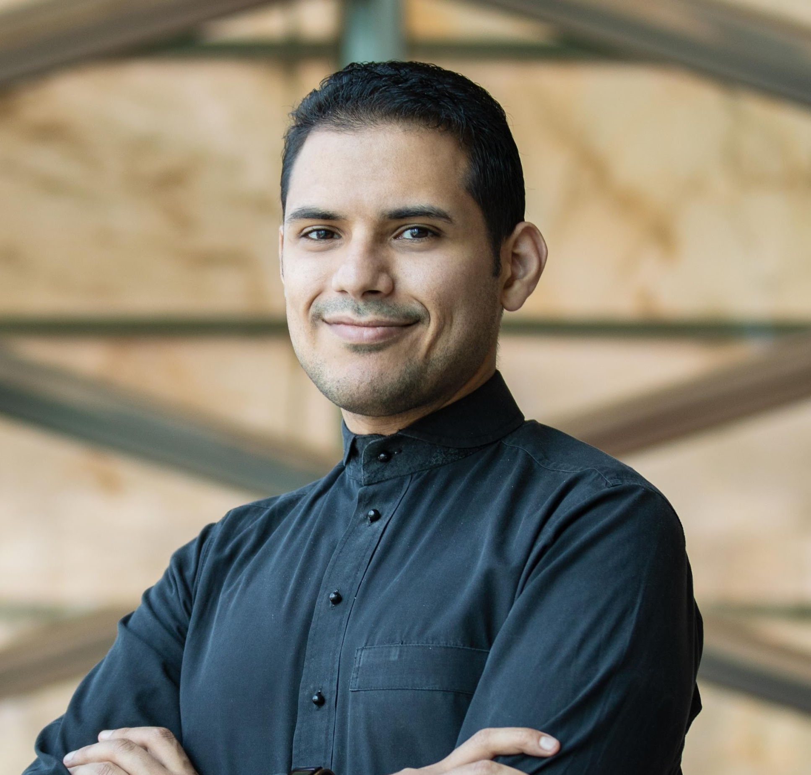
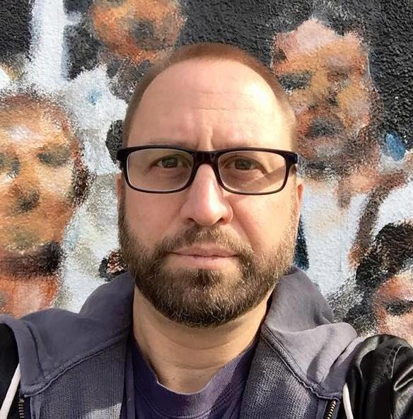
Speakers
Abdulrahman is a founding member of the KAUST Entrepreneurship Center where he has delivered training and mentorship programs for a variety of major events and startup conferences in the Kingdom including, Misk Global Forum, MIT Pan-Arab Enterprise Forum and Arabnet. Additionally, Abdulrahman is a board member in Oqal which is the leading angel investor network in the region.
Abdulrahman Co-leads the TAQADAM University Startups Accelerator and supports a diverse portfolio of early technology start-ups ranging from cleantech to education to social enterprise. In addition, he has advised driven teams from Saudi ARAMCO, SABIC and Islamic Development Bank among many others.
Abdulrahman Aljiffry, Accelerator Manager, KAUST
David Bergantino is an award-winning, multi-platform content creator with over 30 years of experience working with the top studios, publishers and talent in both traditional and interactive entertainment. He’s served as VP of Premium Games Production at Nickelodeon, VP of Creative for THQ’s Kids & Family division and was a producer for Disney Interactive, Jim Henson Interactive, the BBC, Spin Master, Wildbrain, Cabinet Entertainment and Discovery Kids, among others. His console games have sold over 20M units across all platforms, with 10 titles selling over 1M units each, generating over $500M in revenue.
He has written 11 published novels, dozens of video games, and even wrote the story and script for the original Mummy theme park ride at Universal Studios Florida, among other projects.
Author Dustin MacNeil devoted an entire chapter of his book, Slash of the Titans, to David and his contribution to the development of the film Freddy vs. Jason and he will soon appear in the upcoming documentary feature And Also a Major Motion Picture. He is currently working on a diverse slate of projects, including writing for Techland’s Dying Light 2, Evil Lands for Rage Quit Games, an untitled game for NetEase, for which he also created the storyworld, and two games for ByteDance. His latest indie horror game, Re:Turn – One Way Trip, which he wrote, co-produced and co-designed is currently available on Switch, Xbox and Playstation.
David Bergantino, Multi-Platform Content Creator, NetEase
Game Jam Roadmap Continued

Slide 22
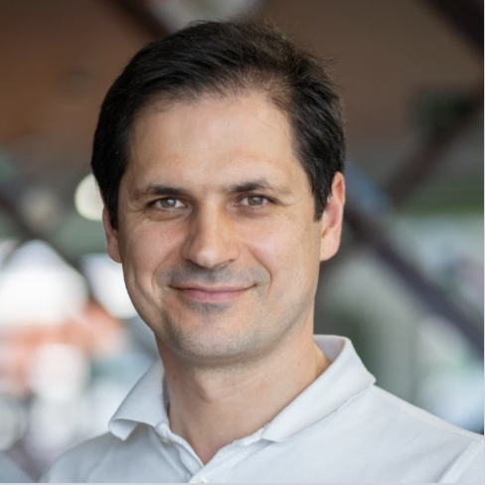
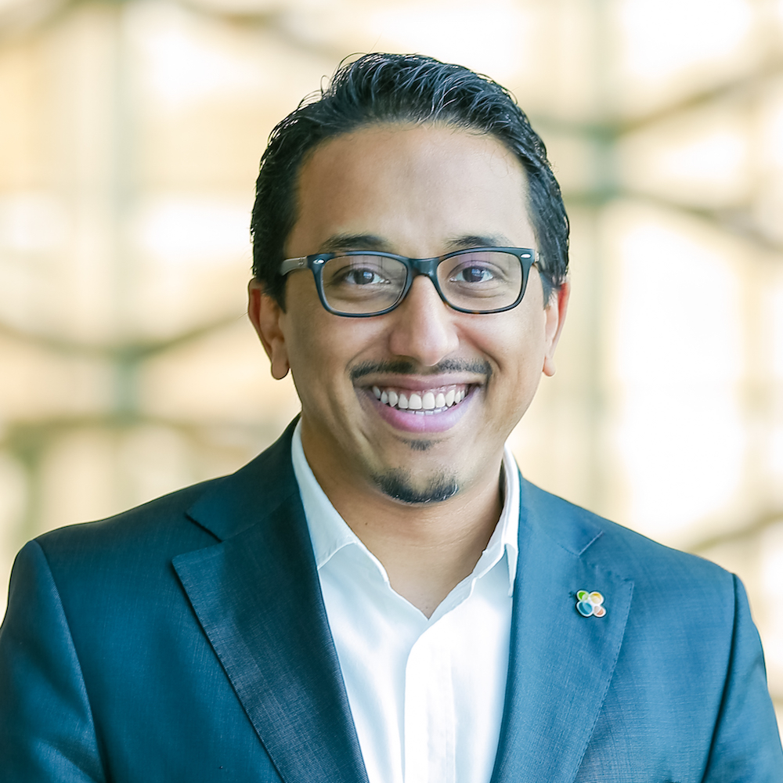
Speakers
David is an experienced professional in gaming industry with more than 15 years experience working in THQ, Digital Chocolate, Nokia, wappier, and King across Product, Marketing, Sales and Business Development. In his tenure at King, he led Bubble Witch 3 Saga and Candy Crush Friends Saga, expanding both Bubble Witch and Candy Crash multi-billion-dollar game franchises for Activision-Blizzard. He also has a complete picture of the mobile ecosystem having worked for telco operators, device manufacturers, service providers as well as developers, being involved in mobile advertising, mobile marketing, mobile services, mobile content, mobile apps and mobile games projects during the past 20 years.
David holds a Master in Telecommunications Engineering from Universidad Politécnica de Madrid as well as an Executive MBA from Instituto de Empresa. David is currently working in Sandsoft as Chief Executive Officer, leading an entrepreneurial team in Saudi Arabia to deliver on their vision to be the leading mobile games publisher & developer in the MENA region as well as to be the destination company to work for and the nucleus of the KSA games industry​. He’s also an angel investor in gaming and tech.
David Fernández, CEO, Sandsoft
Hattan manages several cross-onal initiatives and programs between KAUST and ecosystem players.
Prior to joining KAUST, Hattan had a couple of full cycle entrepreneurial experiences from foundation to exit in Saudi Arabia for three years.
Hattan started his career in software development and has Information Technology (IT) background in different industries ranging from oil and gas, travel to retail.
Hattan holds an MBA degree from University of Leeds and a BS degree in Computer Science from University of Alabama.
Hattan Ahmed, Entrepreneurship Center Manager, KAUST

Slide 23

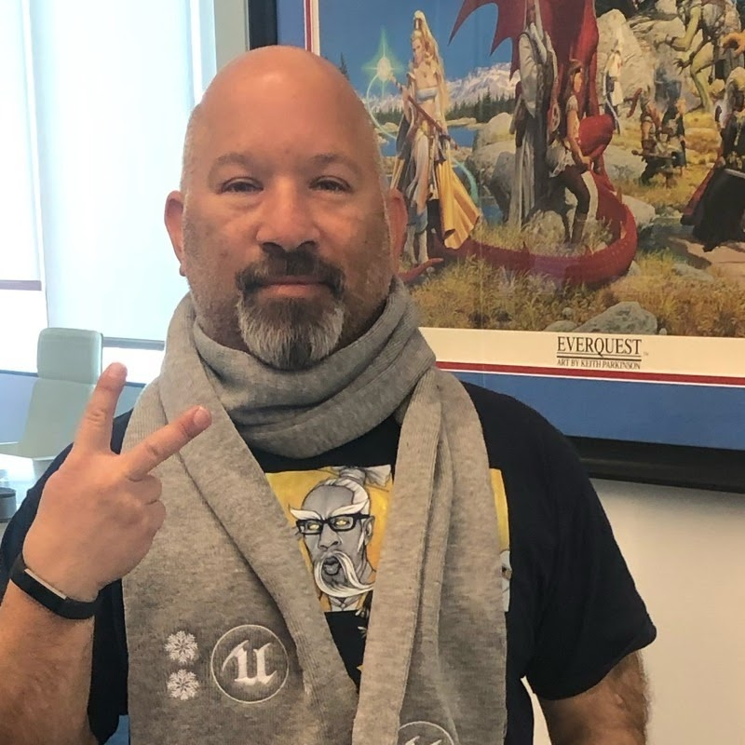
Jeff Nuzzi is a highly accomplished gaming executive with four #1 overall mobile apps to his credit and hundreds of published titles across mobile, PC, and console gaming platforms. As Head of Publishing at Sandsoft, he is responsible for bringing the company’s portfolio of games to market. Prior to Sandsoft, he founded Like Pizza Studios where he produced games and animation for licensed and original content such as the movie musical Grease and classic animation like Mighty Mouse, he previously was head of Digital Media and Games for RGH Entertainment based in Amman, Jordan where he secured licenses with Paul McCartney and helped launch the chart-topping Dumb Ways to Die mobile franchise. At the Walt Disney Company he led the go-to-market effort for the top-selling Where’s My Water, in addition to dozens of apps for Disney franchises such as Cars, Toy Story, and TRON. He also managed Marvel titles Thor and Captain America and sports apps through ESPN. As Director, Global Marketing for THQ Wireless, he acquired mobile rights to and managed mobile licenses for Star Wars, professional sports leagues (NFL, NBA, MLB and NHL), SpongeBob SquarePants, Hello Kitty, Midway Games and WWE among others. Prior to THQ, Mr. Nuzzi held senior level marketing positions at Universal Interactive, managing PlayStation and Xbox titles such as The Thing, The Lord of the Rings, Bruce Lee and The Fast and the Furious; Atari, where he launched games based on Looney Tunes and Peanuts; Fox Interactive, where he worked on Die Hard, Croc, and The Simpsons; And DreamWorks Interactive, which included the Jurassic Park franchise.
Jeff Nuzzi, Head of Publishing, Sandsoft
Speakers
Justin "Dark Yoda" Berenbaum is Vice President of Strategy at Xsolla and GM of Xsolla Funding
Club and has more than 25 years of strategic development experience in the video game industry that includes Activision, 505 Games, Capcom, and many others. His career spans publishing, international business development, sales, customer support, game development,
strategy, and licensing for game developers, publishers, and technology companies. He is a former member of the Global Game Jam Board of Directors and was also a member of the Board of Directors of the International Game Developers Association.
Twitter: @scslug
Justin Berenbaum, Vice President of Strategy Xsolla, GM of Xsolla Funding

Slide 24
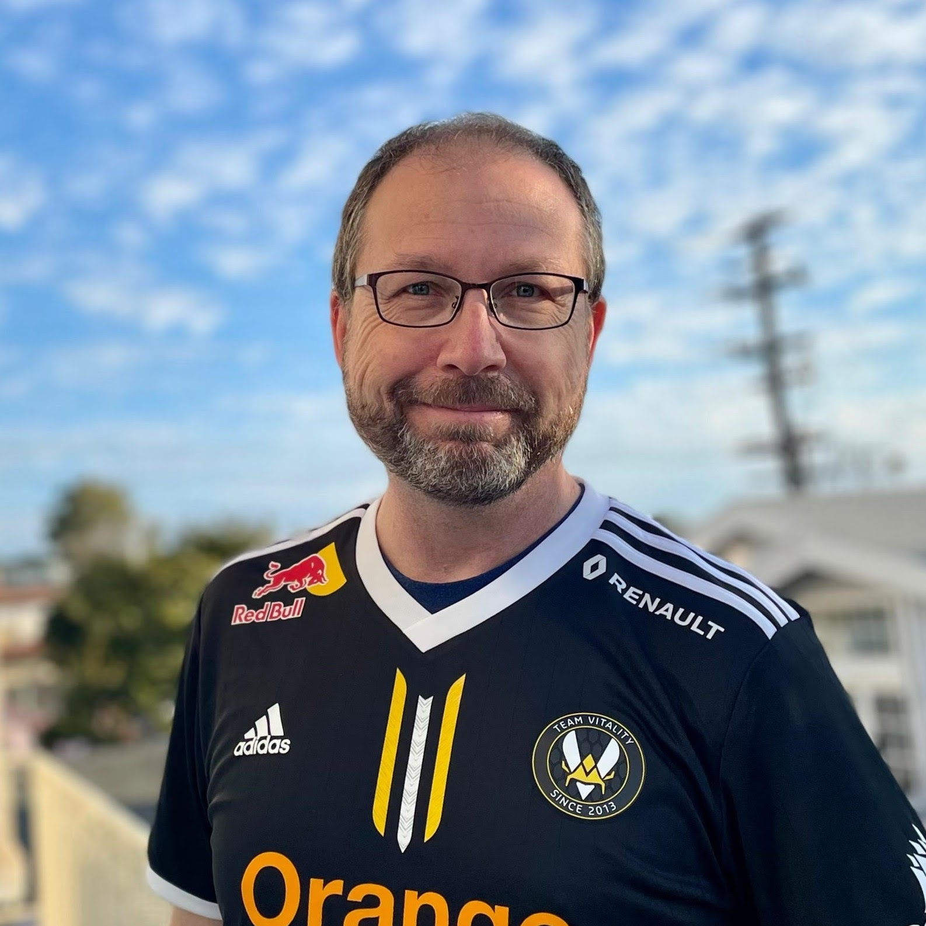

Speakers
I am a former CEO of Square Enix America, head of publishing at Epic Games, head of marketing at Microsoft Xbox, and VP of digital video and music at Amazon. I am currently a professor in the interactive media department at the University of Southern California.
Mike Fischer, Professor in Interactive Media , University of Southern California.
Miquel is an International HR professional in various industries, including 4 years in gaming at King and Activision-Blizzard.
Miquel has proven track record on co-creating and arranging people-centric programs within multicultural and complex organization (Leadership Development, Talent Management, Change Management, among others), adding value to both the organizational development and the talent boosting. Miquel is also a former basketball player and coach.
Miquel Muñoz, Head of HR, Sandsoft

Slide 25

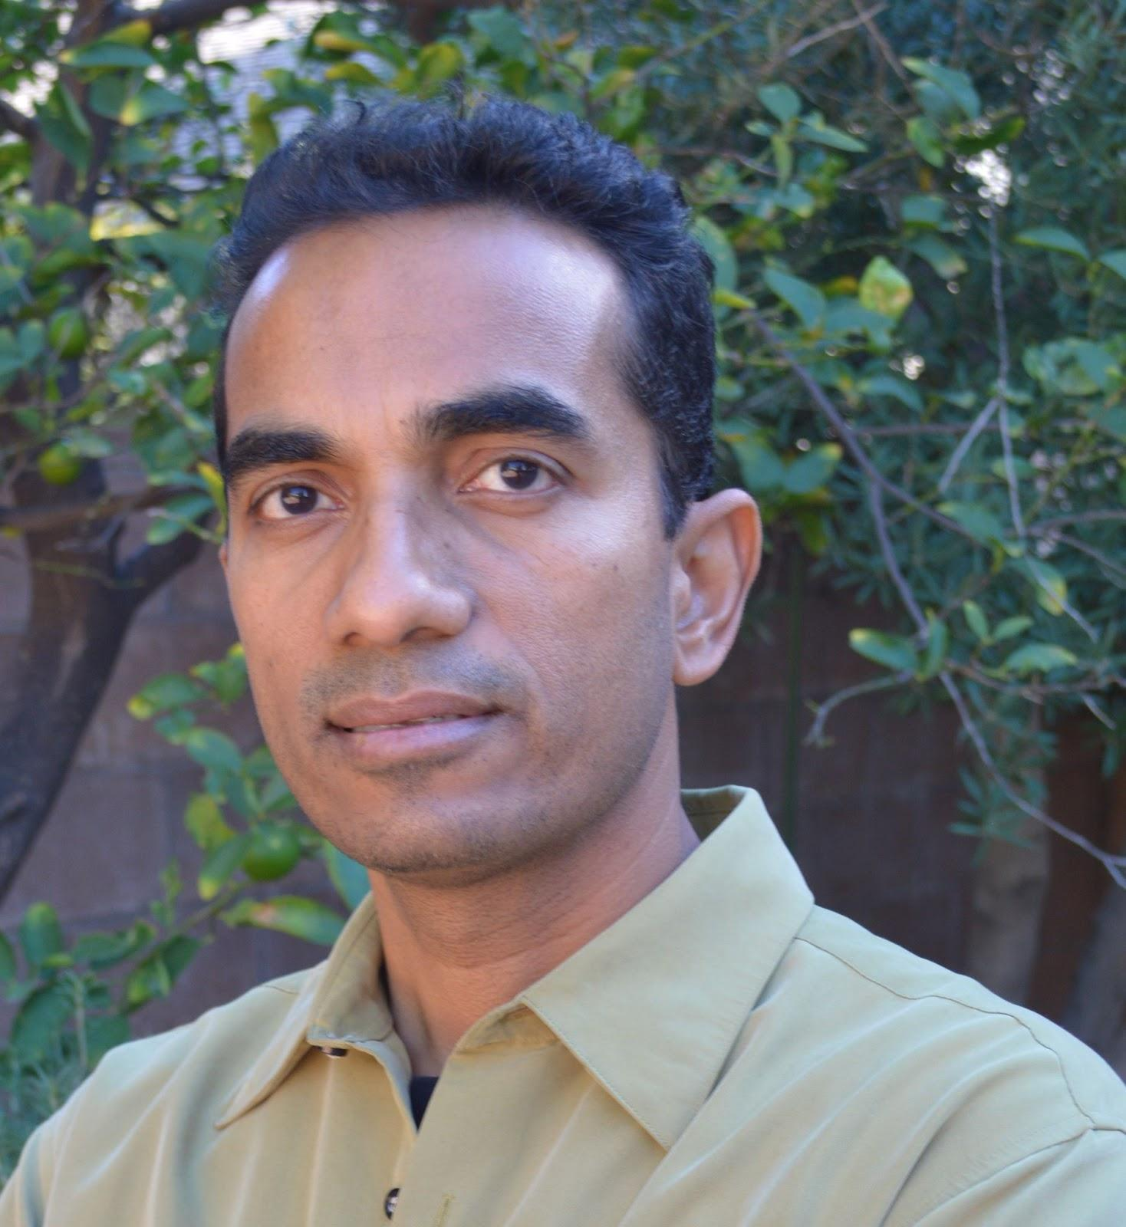
Speakers
Richard Ludlow is the Audio Director and co-Founder of Hexany Audio, a Los Angeles based sound and music studio specializing in audio for games, VR (Virtual Reality), and interactive media. Richard has worked on projects for Disney, Activision, Riot Games, Ubisoft, Warner Bros, Universal, Amazon, Sony, Apple, Marvel, Tencent, and many more.
Richard Ludlow, Audio Director and Co-Founder, Hexany Audio
Sunil Thankamushy is a video game industry animation director and creative executive who was part of the core teams that developed highly acclaimed, and successful video game franchises such as CALL OF DUTY™: FINEST HOUR™, MEDAL OF HONOR™, etc. Blending technology and animation have been a passion for Sunil. In the various enterprises he has been involved in - gaming, animation, robotics, educational products - he has endeavored to use technology to improve the level of immersion for the user. Besides all his ventures, Sunil is also a faculty at Mt.San Antonio college near Los Angeles, helping lead the animation and gaming program, and directing its Virtual Reality program.
Sunil Thankamushy, Industry Animation Director and Creative Executive

Slide 26
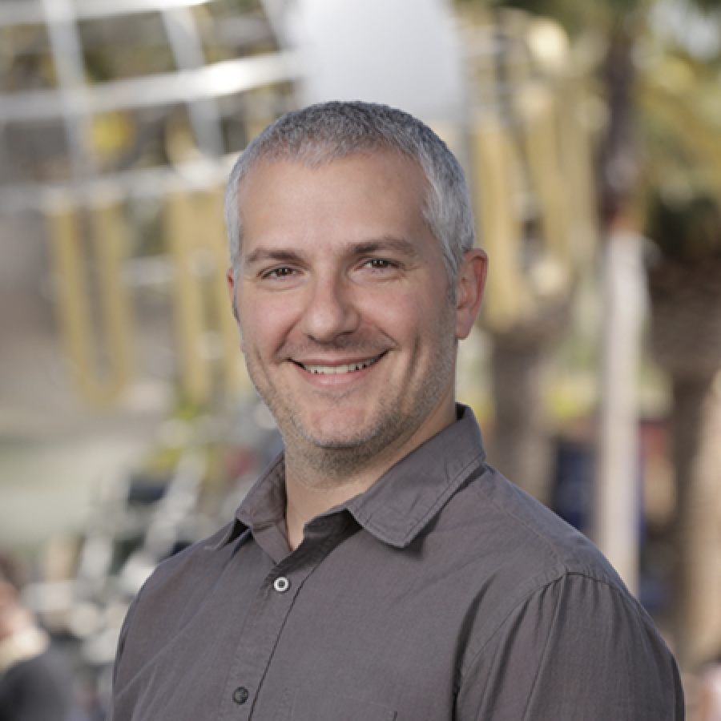
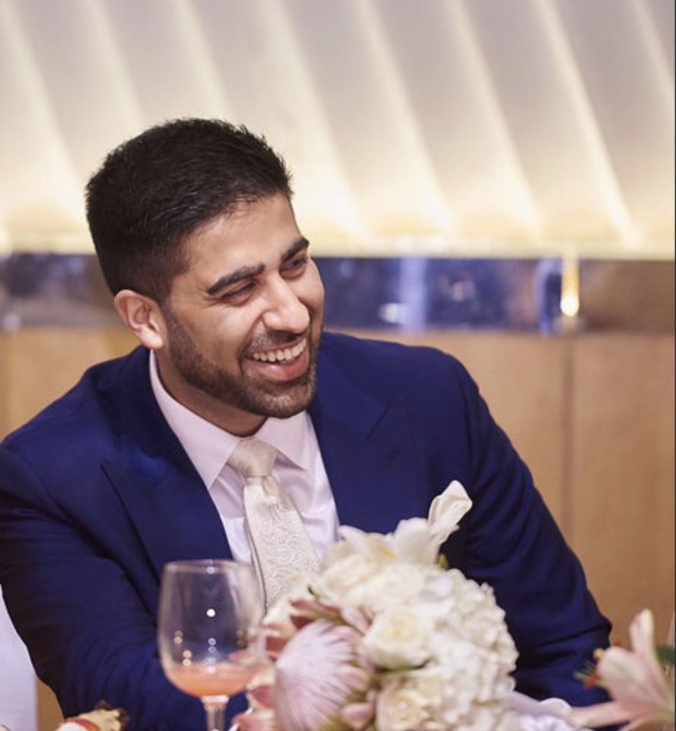
Speakers
A lifelong and constant creator, Tim found his calling in game development. He majored in Film Studies at the University of Colorado Boulder, and also had a passion for computers from an early age.
In high school Tim learned how to program his own video games and kept that up as a hobby through college and early work life in Japan, first teaching English and later working on a Japanese Television show as assistant director.
Tim got his start in the games industry in quality assurance at Disney, quickly turning that into an associate producer role, and later game designer. There he started a mobile development team who went on to create Disney’s biggest early App Store successes "JellyCar" and “Where’s My Water?”. That led to more senior creative positions at both Disney and later NBCUniversal as Vice President, Games Creative, where he led a team of designers and artists who helped solve creative challenges for games, and pitch new game concepts.
Tim is now a full-time independent creator, releasing solo games under the name "Walaber" (Pro Gymnast, JellyCar), and is also half of the two-person game company "Toyful Games" (Very Very Valet).
Tim Fitzrandolph, Independent Creator and Co-Founder, Toyful Games
Yahsir Qureshi is an Executive Producer @Sandsoft. ex-Electronic Arts, Zynga 13+yrs Experience in the Gaming Industry. Worked on FIFA, Need for Speed, Battlefield, CSR Racing 2, Dawn of Titans amongst others.
Yahsir Qureshi, Executive Producer, Sandsoft

Slide 27
The KAUSTxSandsoft Game Jam is about experimentation, sharing, collaboration and learning from each other. All Jammers are expected to share their games by uploading their games, assets, source code etc.
Games are uploaded under the Attribution-NonCommercial-ShareAlike 4.0 Creative Commons license (https://creativecommons.org/licenses/by-nc-sa/4.0/
This basically means the team that created the game, owns the original content and can do with it as they please, and that KAUSTxSandsoft Game Jam retains an original copy that other people can download, modify and distribute for non-commercial purposes.
All files necessary to run the game, as well as all assets, source code and project files created during the jam and necessary to rebuild/compile & link the game from scratch must be uploaded as well. Third party tools, libraries, engines and assets that are used for the game, but not created during the game jam, may be omitted from the game jam project submission. However, clear instructions must be included on how to purchase or obtain these resources in order to continue development on the game.
KAUSTxSandsoft Game Jam also reserves the right to remove any uploaded games if the content is offensive or unsuitable. This includes but is not limited to: games with harmful or prejudicial themes related to gender, sexual orientation, age, ability, appearance, ethnicity, national origin, citizenship, socioeconomic status, or religion.
Content Policy
Game Jam Roadmap Continued

